Slide 1
DRGs

Slide 2
The UCR boondoggle
  The tail wagged the dog
Prices >> cost
  Heart surgery
  AV-1000
Price variation
Service variation (non-profit vs for-profit)
Persistent excess capacity with high average cost

Slide 3
Diagnosis-Related Groups for Hospital Payment
Medicare introduced DRGs in 1983, phasing it in through 1988. SC Medicaid adopted DRG-based payment in 1986. Modified to hybrid system in 1987.
DRG-based prospective payment puts every patient into one of about 600 DRGs, according to the patient's diagnoses.
The DRG determines the payment to the hospital (except for very long stay outliers).

Slide 4
Diagnosis-Related Groups for Hospital Payment
Each DRG has a "weight" that represents the cost of treating such a patient relative to the average of all patients.
Payment = (The dollar amount for a DRG with weight = 1) multiplied by the weight of patient’s DRG.
Adjusting one dollar amount adjusts all the payments.

Slide 5
SC Medicaid shortly after DRG’s started

Slide 6
OBS DRG DIAG1 DIAG2
1 391 V3000
2 391 V3001
3 391 V310
4 391 V3000 605
5 391 V3000 7661
6 391 V3000
7 391 V3001
8 391 V3001 7661
9 391 V3000 605
10 391 V3000
11 391 V3001
21 391 V3000
22 391 V3000
23 391 V3000 7746
24 391 V3101
27 391 V3000 7746
28 391 V3000 7661

Slide 7
OBS DRG DIAG1 DIAG2 DIAG3 DIAG4 DIAG5
1 390 V3000 7525
2 390 7786 7660
3 390 V301 7526 V718
4 390 V3000 7526
5 390 V3101 7784
6 390 V3000 4279
7 390 V3000 37205
8 390 V3000 76408
9 390 V3000 7526
10 390 V3000 7706
11 390 V3001 71965 7706 7746
12 390 V3000 7661 74910
13 390 V3000 7793
14 390 V3000 7706
15 390 V3000 75501
16 390 V3001 7526
17 390 V3001 V718

Slide 8
OBS DRG DIAG1 DIAG2 DIAG3 DIAG4 DIAG5
1 389 V3000 7701
2 389 V3001 7731
3 389 7701 7718 V3001 0389 7792
4 389 7718
5 389 V3001 7708 5531
6 389 V3000 76408 7731
7 389 V3000 7661 7731
8 389 V3101 7731
9 389 V3000 7731
10 389 V3000 7731
11 389 V3000 7454
12 389 V3000 7708
13 389 V3001 7731
14 389 7756 7824
15 389 V3001 7708 7718 75462 7746
16 389 V3001 7795 7863 7706
17 389 7732 7526

Slide 9
DRG payment and medical records
Suddenly, a profit center
DRG creep
  Recording of diagnoses, and order of diagnoses, mattered

Slide 10
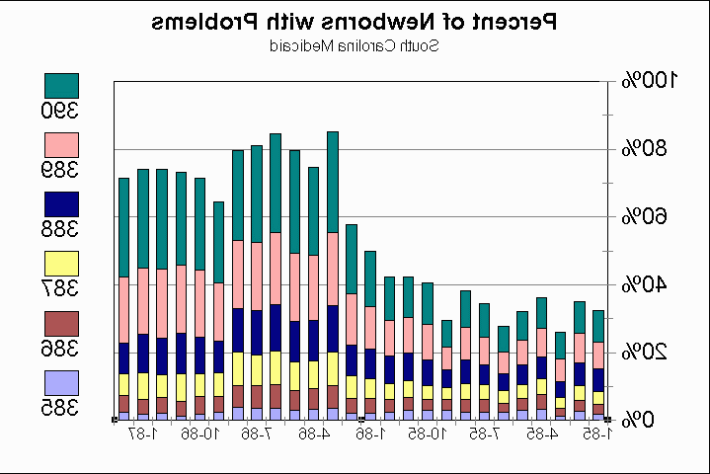

Slide 11
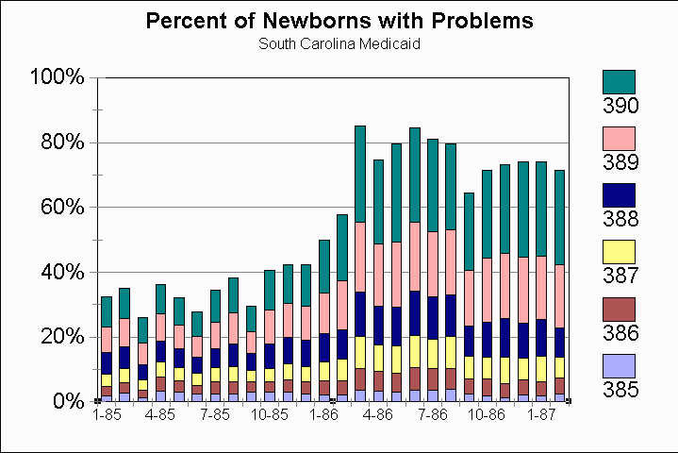

Slide 12
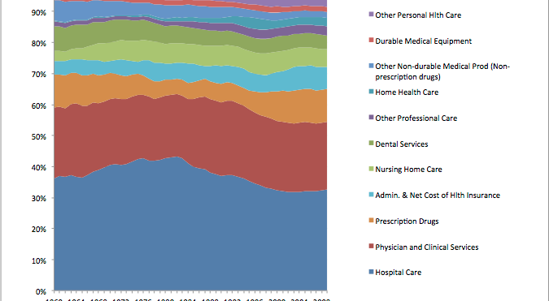
Effect of DRG payment

Slide 13
‘QUICKER AND SICKER’ UNDER MEDICARE’S PROSPECTIVE PAYMENT SYSTEM FOR HOSPITALS: NEW EVIDENCE ON AN OLD ISSUE FROM A NATIONAL LONGITUDINAL SURVEY
Xufeng Qian,∗ Louise B. Russell,† Elmira Valiyeva‡ and Jane E. Miller§

Slide 14
Quicker and sicker with PPS
Direct discharges to nursing homes from hospitals jumped
  and may have risen further in the early 1990s when payment rates were tightened and as hospitals’ discharge planning improved and home health expanded.
Admissions to nursing homes from the community of recently discharged hospital patients more than tripled under PPS.

Slide 15
Quicker and sicker with PPS
Based on regression model that controlled for the health of patients
On average, hospitalized patients were sicker, thanks to
  Peer Review Organizations,
  $ for outpatient surgery,
  …

Slide 16
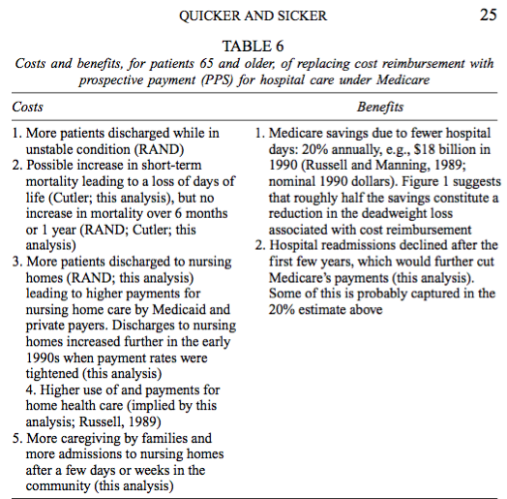

Slide 17
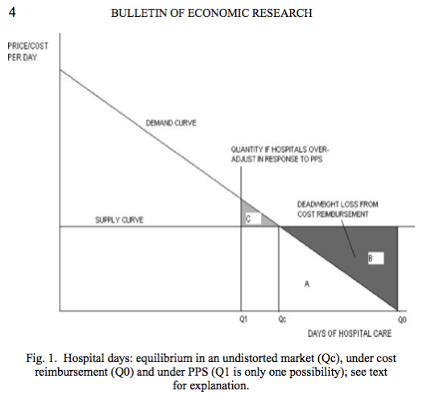

Slide 18
RBRVS

Slide 19
Resource-Based Relative Value System for physician payment
In the late 1980s, Medicare led a direct attack on how physicians set their prices. Medicare implemented the Resource-Based Relative Value System for paying doctors.
It's now used, in various forms, by private as well as public payers.

Slide 20
RBRVS = DRGs for doctors?
No
  DRG-based payment is prospective. It pays a certain amount per case, regardless of what resources the hospital puts in to the patient’s care.
  RBRVS is fee-for-service payment

Slide 21
RBRVS = DRGs for doctors?
But Yes in the sense that
  Both came from the US government
  Both simplify payment-setting
    Both based on giving a weight to each unit of service
    Weight is proportional to the cost of the service
    Costs are determined by formula, not existing market prices
    Payment = (Payment for a service with weight = 1) × (Weight of the service)

Slide 22
Historical context
  Roe, B.B., "The UCR Boondoggle: A Death Knell for Private Practice?" N Engl J Med, July 2, 1981, 305(1), pp. 41-45.
Medicare used Usual and Customary Rates as the basis for pricing doctor services.
Invited abuse. In 1981, a heart surgeon could do three 2-4 hour coronary bypass surgeries per week at $2500 each and make $350,000 annually.

Slide 23
RBRVS
RBRVS was intended to set fees by simulating the fees the market would have set if the market functioned properly.
With prices having a consistent relationship with cost.
Hsiao, W.C., Braun, P., Dunn, D., Becker, E.R., DeNicola, M., Ketcham, T.R., "Results and Policy Implications of the Resource-Based Relative-Value Study," N Engl J Med, September 29, 1988, 319(13), pp. 881-888.
This article, which is printed second in the original magazine, gives the general idea of RBRVS.

Slide 24
Physician work measure for RBRVS
Hsiao, W.C., Braun, P., Yntema, D., Becker, E.R., "Estimating Physicians' Work for a Resource-Based Relative Value Scale," N Engl J Med, September 29, 1988, 319(13), pp. 835-841.
This article (printed first in the NEJM issue) looks specifically at how they measured the physician's work entailed in any particular procedure.

Slide 25
The goal
Hsiao, an actuary by training, was later a major consultant to the Taiwan government for the reform of its health insurance system.
Here, he suspected that physician fees were out of proportion to cost, with some surgical specialties much more handsomely reimbursed than primary care.
Making the fees proportional to cost would encourage physicians to pursue careers in "primary care, rural practice, and out-of-hospital services," rather than flocking to surgical specialties.

Slide 26
RBRVS formula
RBRV = (TW)(1+RPC)(1+AST)
Resource-Based Relative Value = (Total Work)× (Specialty Practice Cost Index)×(Specialized Training Cost Index)
Specialty practice cost is hired labor and capital
Specialized training cost is the opportunity cost of spending time in residency.

Slide 27
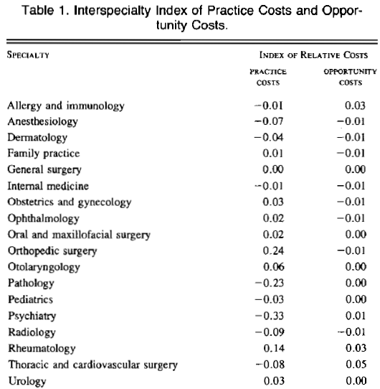

Slide 28
Total Work formula
Total Work = Time×(Complexity Index)
Complexity index = “sweat factor”
Includes Pre- + Intra- + Post-service work
Based on surveys of physicians

Slide 29
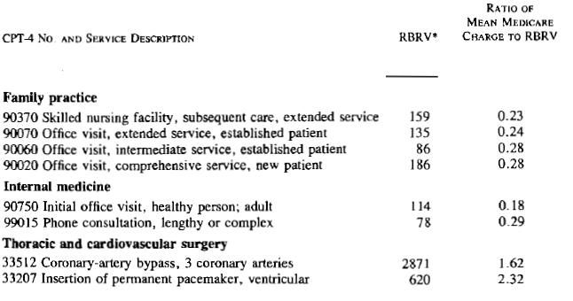
Compares actual Medicare payments with what Medicare would pay if proportional to RBRV and total-payment-neutral

Slide 30
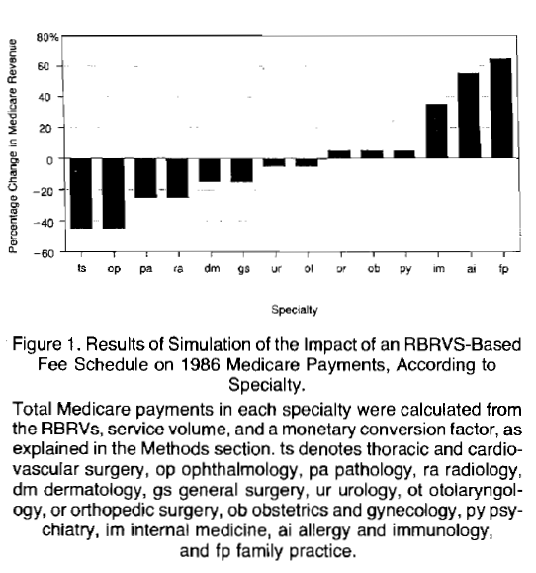

Slide 31
Potential RBRVS impact
If Medicare fees were adjusted to the RBRVS but total spending unchanged ("budget-neutral"), thoracic surgery, ophthalmology fees would drop >40%. General surgery fees would drop about 15%.
Internal medicine fees would rise >30%. Family practice fees would rise >60%.
Ontario's negotiated fee schedule more uniform relative to RBRV than mean Medicare payment.

Slide 32
Limitations of RBRVS
  which Hsiao recognized:
The CPT-4 classification system for physician services, like any classification system, has variations within the classes. Some docs, such as those who treat poor people, may have more difficult patients within RBRV classes.
No extra payment is allowed for better outcomes. RBRVS is based on resource inputs, not benefits. There's no financial incentive for higher quality.

Slide 33
As implemented by SC Medicaid
Naus, F., Medical Management Institute 1991
Nose fracture CPT 21325
RVU category | US | SC adj | SC RVU
Work RVU | 174 | 0.971 | 169.1
Overhead RVU | 120 | 0.874 | 105.1
Malpractice RVU | 20 | 0.457 | 9.14
Total | 314 |  | 283.3

